Slide 1
BUILDING A PRIVATE CLOUD (Building PaaS using IaaS)
Presented by:
Lohitha Yenugu
Rahul Dhamerla

Slide 2
Problem Statement
To explore the possibility of designing an efficient Cloud framework for optimal utilization of storage space, improved resource availability and load balancing across the cluster of nodes.

Slide 3
Solution
Developing a system on which:
Users can create or destroy the cloud services like web servers and databases by using web client on demand.
Users can configure the memory and CPU usage of a service.
Users are billed according to the usage of resources.

Slide 4
Platform/Tools/Languages
Docker
Docker Swarm
Cloud Lab
Rest API
JSP
MongoDB
Net Beans IDE,PostMan

Slide 5
System Architecture
HTTP REST API
MongoDB
JSP
Browser
Docker Swarm
Docker
Cloud Lab Node
Docker
Cloud Lab Node
Docker
Cloud Lab Node
Docker
Cloud Lab Node

Slide 6
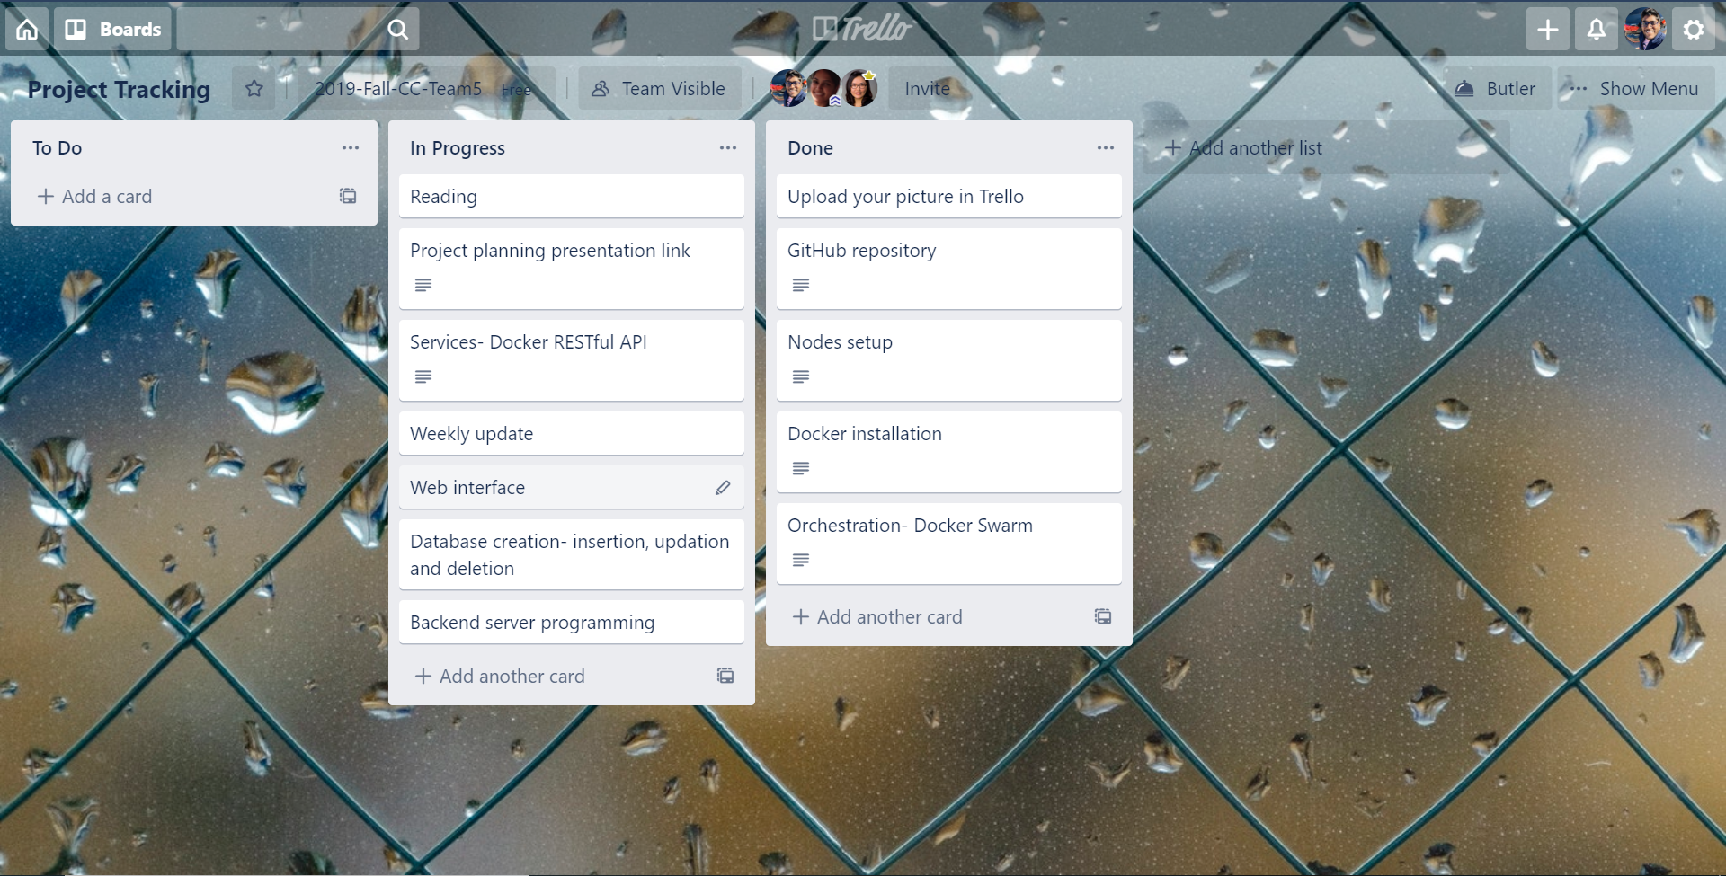
Project Progress

Slide 7
Screenshots

Slide 8
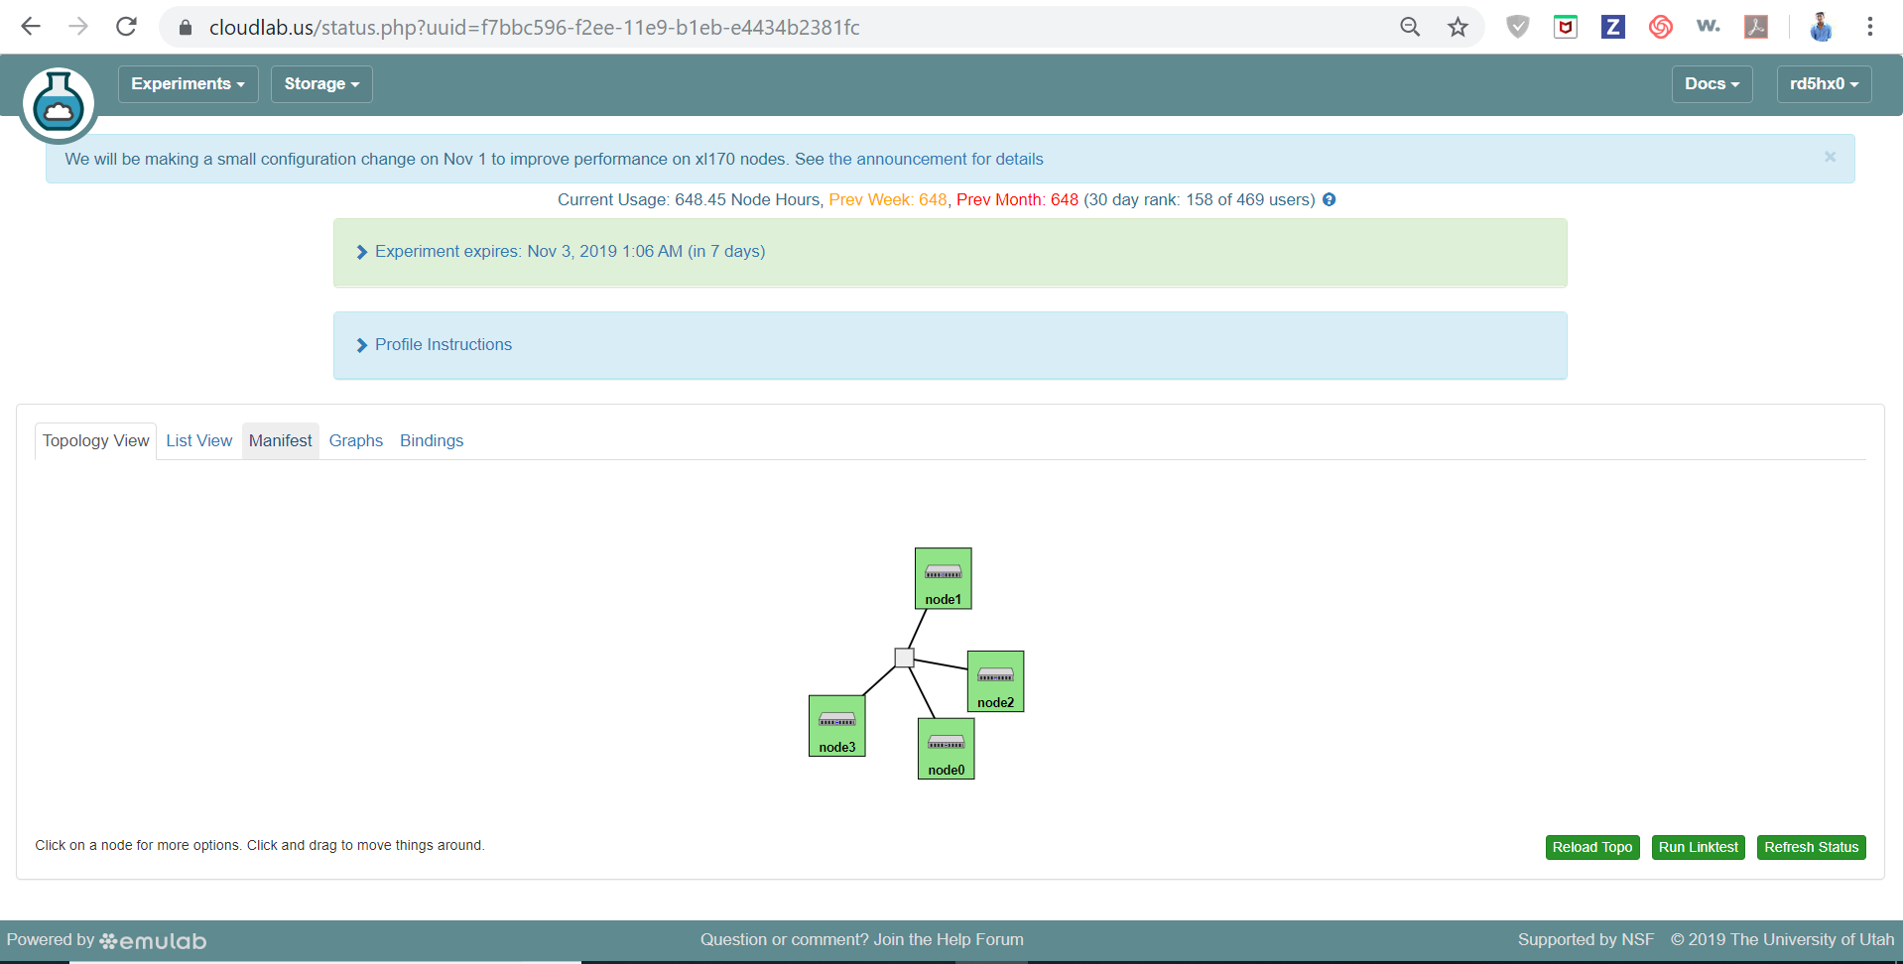
Nodes setup

Slide 9
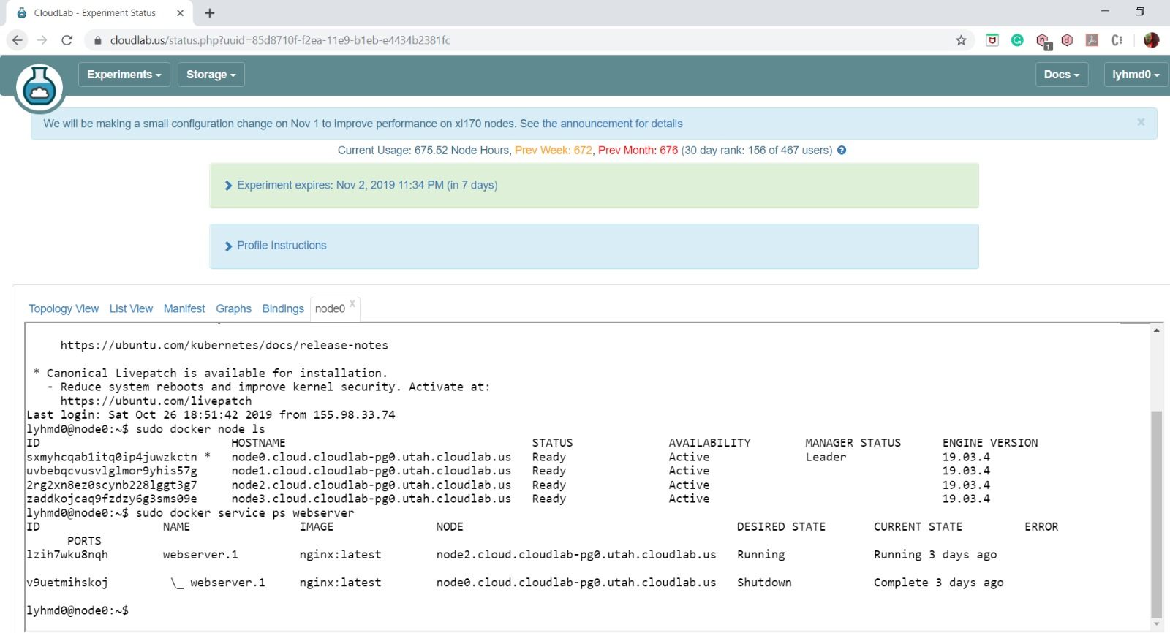
Docker Swarm

Slide 10
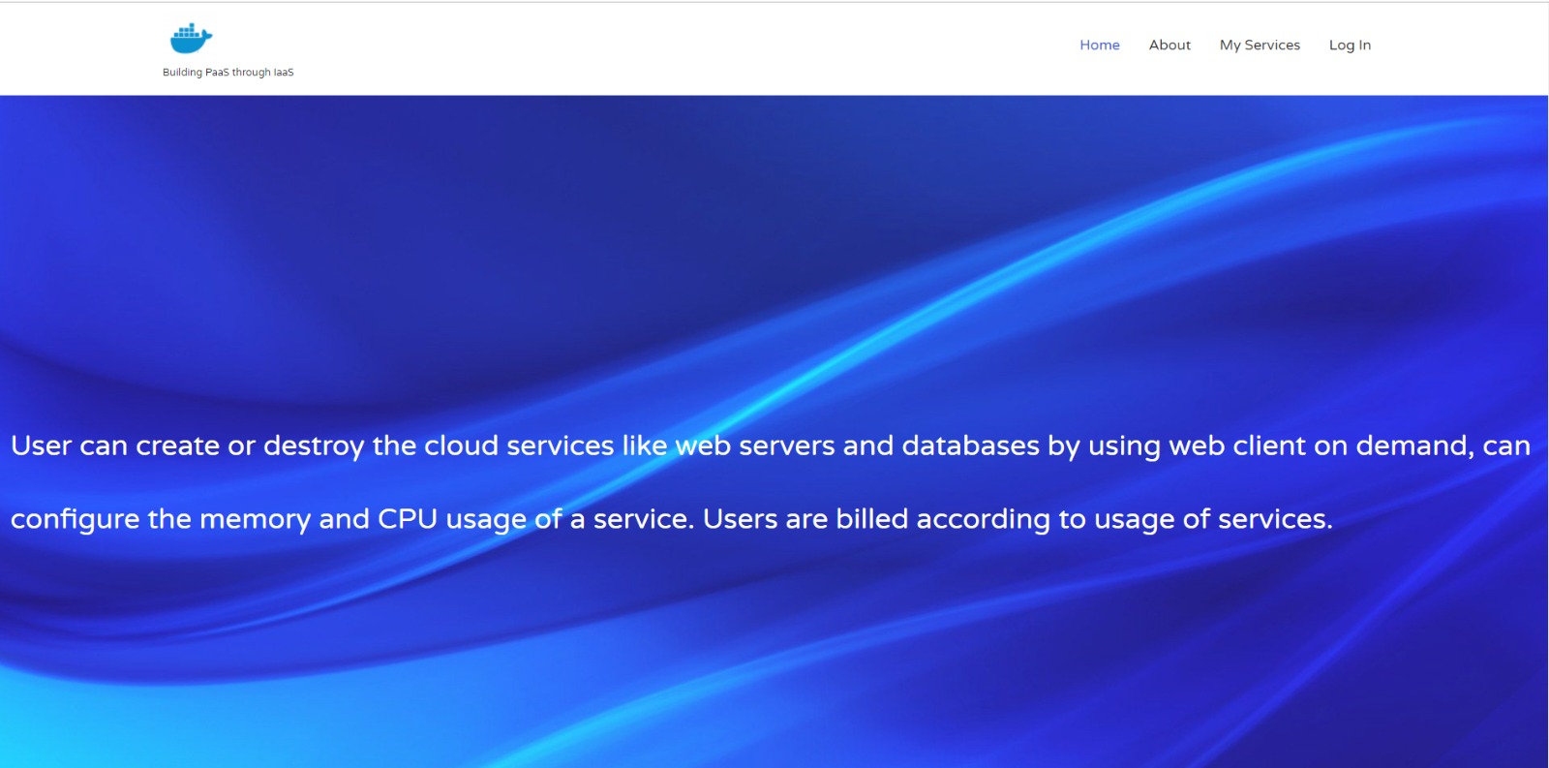
Home

Slide 11
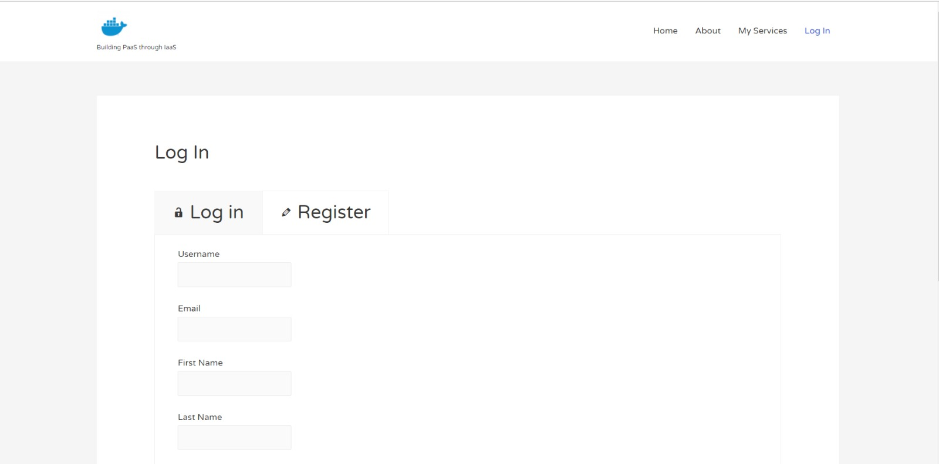
Register

Slide 12
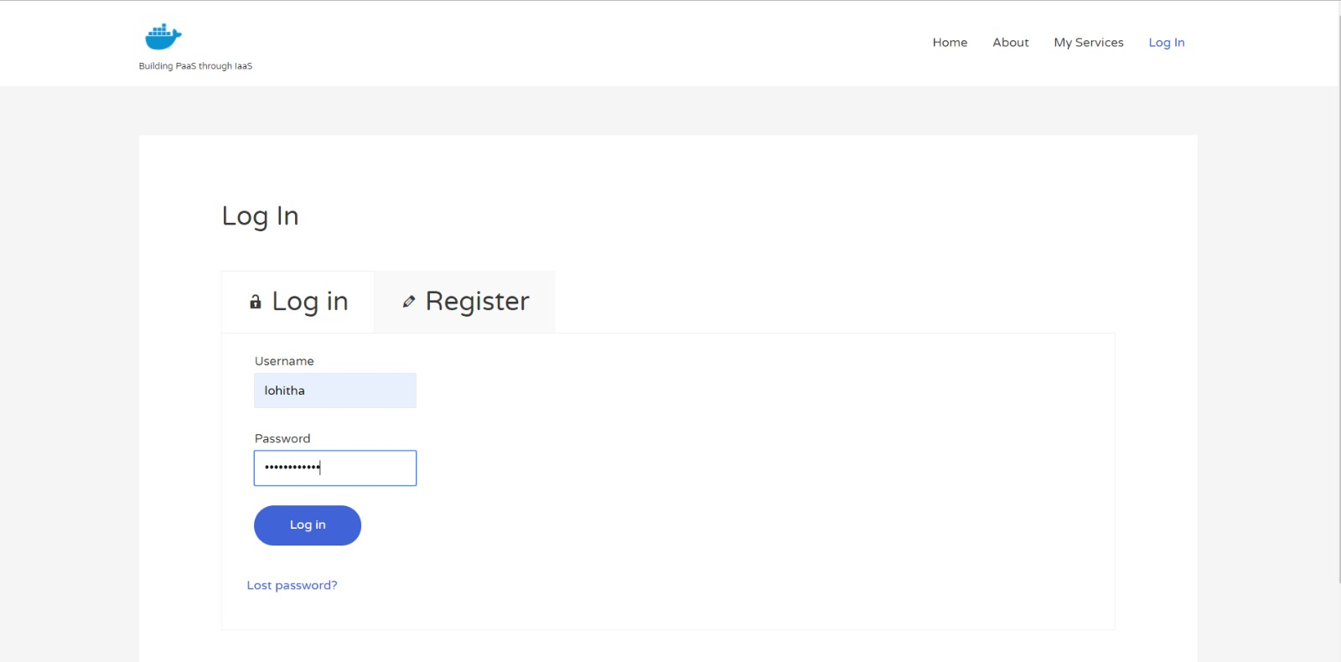
Login

Slide 13
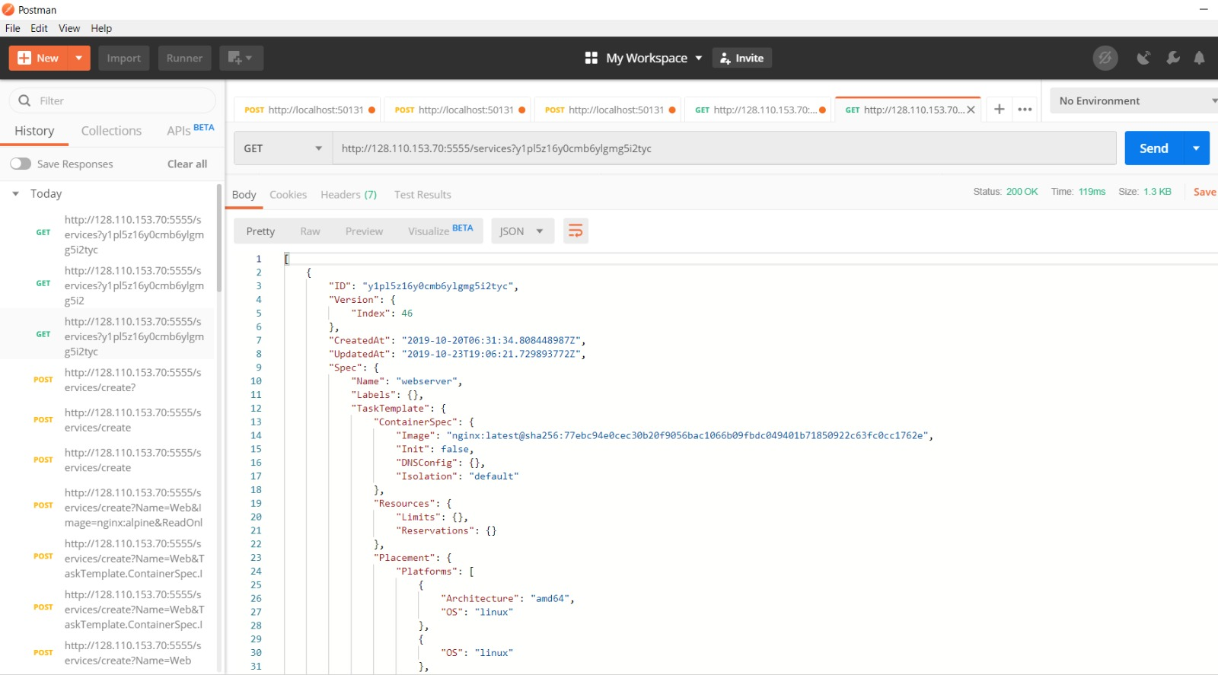
GET Docker REST API

Slide 14
Thank You

